Slide 1
Machine Learning
AIML CZG565
M8 : Bayesian Learning
Course Faculty of M.Tech Cluster
BITS – CSIS - WILP

Slide 2

Machine Learning
Disclaimer and Acknowledgement
These content of modules & context under topics are planned by the course owner Dr. Sugata, with grateful acknowledgement to many others who made their course materials freely available online
We here by acknowledge all the contributors for their material and inputs.
We have provided source information wherever necessary
Students are requested to refer to the textbook w.r.t detailed content of the presentation deck shared over canvas
We have reduced the slides from canvas and modified the content flow to suit the requirements of the course and for ease of class presentation
Slide Source / Preparation / Review:
From BITS Pilani WILP: Prof.Sugata, Prof.Chetana, , Prof.Monali, Prof.Rajavadhana
External: CS109 and CS229 Stanford lecture notes, Dr.Andrew NG and many others who made their course materials freely available online

Slide 3
Course Plan
M1 | Introduction & Mathematical Preliminaries
M2 | Machine Learning Workflow
M3 | Linear Models for Regression
M4 | Linear Models for Classification
M5 | Decision Tree
M6 | Instance Based Learning
M7 | Support Vector Machine – Planned to be discussed in CS 15 or CS 16
M8 | Bayesian Learning
M9 | Ensemble Learning
M10 | Unsupervised Learning
M11 | Machine Learning Model Evaluation/Comparison

Slide 4
Bayesian Learning
Parameter Estimation
Where does the cost come from? - Logistic regression
Why least-squares cost function, be a reasonable choice? – Linear regression

Slide 5
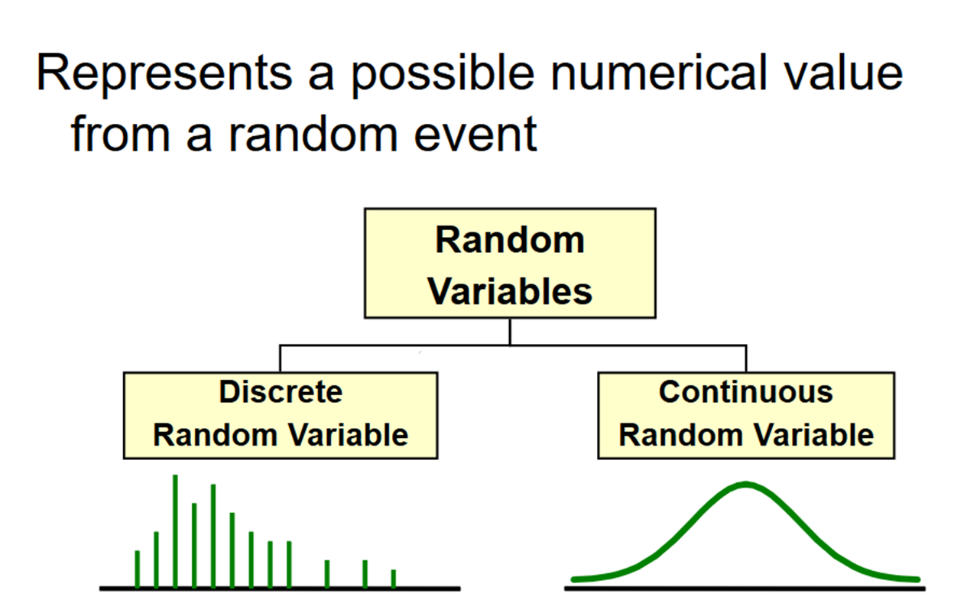
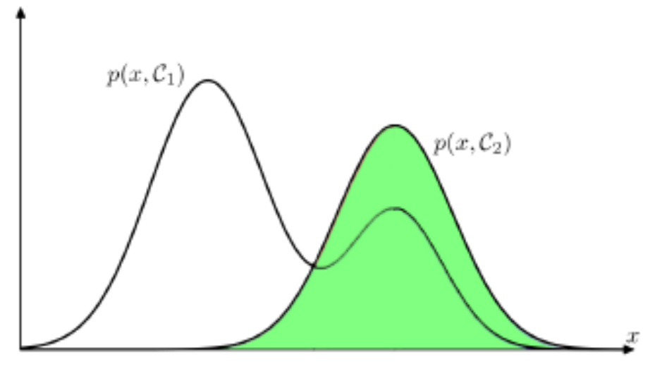
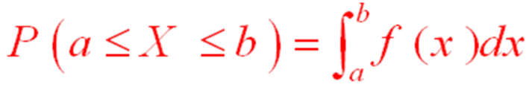
Distribution
Mileage (in kmpl) | Car Price (in cr)
9.8 | 10.48
9.12 | 1.75
9.5 | 6.95
10 | 2.51
Mileage (in kmpl) | Car Price (in cr)
Neutral | High
Less | Low
Neutral | Medium
More | Low
Mileage (in kmpl) | Car Price (in cr)
9.8 | High
9.12 | Low
9.5 | High
10 | Low

Slide 6
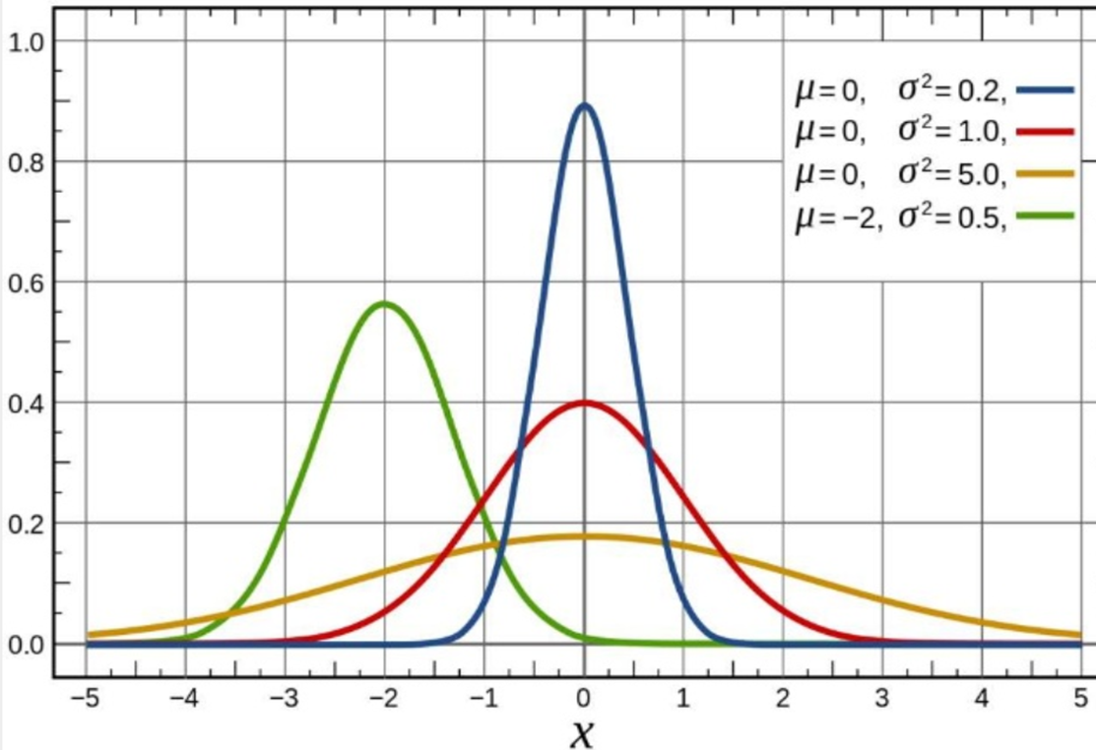
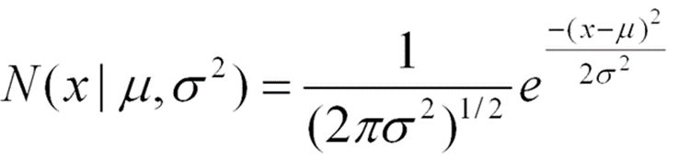
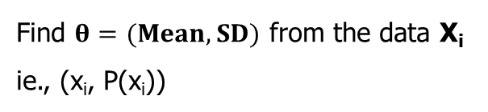
Parameter Estimation
𝜃 is the parameter of a distribution. 𝜃 can be a vector of parameters
Distribution = model + parameter 𝜃
Find $θ=(Mean, SD)$ from the data X_{i}
ie., (x_{i}, P(x_{i}))

Slide 8


Parameter in ML
Mileage (in kmpl) | Car Price (in cr)
9.8 | 10.48
9.12 | 1.75
9.5 | 6.95
10 | 2.51
CarPrice = 8.5 + 0.5 Mileage – 1.5 Mileage²
Parameters : ($θ$₀, $θ$₁, $θ$₂)
Mileage (in kmpl) | Car Price (in cr)
9.8 | High
9.12 | Low
9.5 | High
10 | Low
CarPrice $=\frac{1}{1+e^{−\text{8.5 + 0.5 }\text{Mileage}\text{ – 1.5 }\text{Mileage}\text{2}}}$

Slide 9


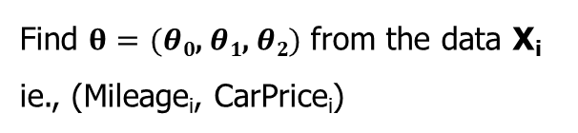
Parameter Estimation in ML
Mileage (in kmpl) | Car Price (in cr)
9.8 | 10.48
9.12 | 1.75
9.5 | 6.95
10 | 2.51
Assumption: Data are__
  IID samples: X₁…X_{n}
  where all X_{i} are independent and have the same distribution.
  Either same PMF (discrete) or same PDF (continuous)
f (X | 𝜃)
  Likelihood of different values of X depends on the values of our parameters 𝜃
  f( ) is either PDF or PMF
CarPrice = 8.5 + 0.5 Mileage – 1.5 Mileage²
y^{(i)} = θ^{T} x^{(i)} + ε^{(i)}
ε^{(i)} ∼ N(0, σ²)
Parameters : ($θ$₀, $θ$₁, $θ$₂)
Find $θ=(θ\text{0}\text{, }θ\text{1}\text{, }θ\text{2})$ from the data X_{i}
ie., (Mileage_{i}, CarPrice_{i})
  Maximum Likelihood Estimation (MLE)
    select that parameters 𝜃 that make the observed data the most likely
  Maximum A Posteriori (MAP)
    choose the parameters 𝜃 that is the most likely, given the data
f (X₁ , X₂ .....X_{n} | $θ$)
f ($θ$ | X₁ , X₂ .....X_{n})

Slide 10


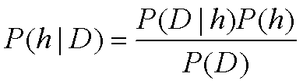
Intuition of Bayes Theorem
MAP : f ($θ$ | X₁ , X₂ .....X_{n})
MLE: f (X₁ , X₂ .....X_{n} | $θ$)
P(h) = prior probability of hypothesis h
P(D) = prior probability of training data D
P(h|D) = probability of h given D
P(D|h) = probability of D given h
𝐿 𝜃 , probability of data given parameter 𝜃
After seeing data, posterior belief of 𝜃
likelihood
prior
posterior
𝑃 𝜃 data =
𝑃 data 𝜃 𝑃 𝜃
𝑃 data
Before seeing data,
prior belief of 𝜃
e.g. what is distribution over parameters θ

Slide 11
Maximum Likelihood Estimation (MLE)
Determine formula for 𝐿𝐿(𝜃)
Differentiate 𝐿𝐿(𝜃) w.r.t. (each) 𝜃
Solve

Slide 12

MLE – Linear Regression Model
Given the noise ε^{(i)} obeys a Normal distribution each y^{(i)} must also obey a Normal distribution around the true target value
Mileage (in kmpl) | Car Price (in cr)
9.8 | 10.48
9.12 | 1.75
9.5 | 6.95
10 | 2.51
CarPrice = 8.5 + 0.5 Mileage – 1.5 Mileage²
y^{(i)} = θ^{T} x^{(i)} + ε^{(i)}
ε^{(i)} ∼ N(0, σ²)
Parameters : ($θ$₀, $θ$₁, $θ$₂)
Find $θ=(θ\text{0}\text{, }θ\text{1}\text{, }θ\text{2})$ from the data X_{i}
ie., (Mileage_{i}, CarPrice_{i})
y^{(i)} | x^{(i)}; θ ∼ N(θ^{T} x^{(i)}, σ²)
  Maximum Likelihood Estimation (MLE)
    select that parameters 𝜃 that make the observed data the most likely
f (X₁ , X₂ .....X_{n} | $θ$)

Slide 13
MLE – Linear Regression Model
Determine formula for 𝐿𝐿(𝜃)
Differentiate 𝐿𝐿(𝜃) w.r.t. (each) 𝜃
Solve
Mileage (in kmpl) | Car Price (in cr)
9.8 | 10.48
9.12 | 1.75
9.5 | 6.95
10 | 2.51
MLE answers the question: For which parameter value does the observed data have the largest probability?

Slide 14
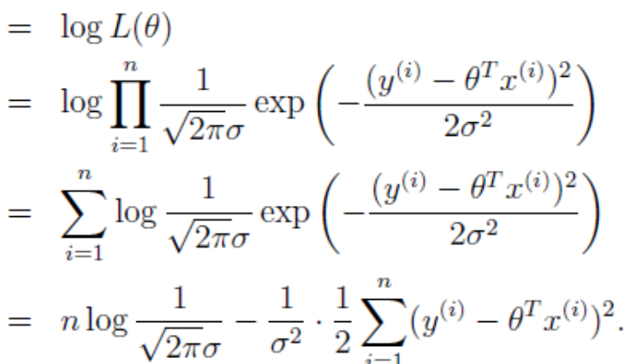
MLE – Linear Regression Model
Determine formula for 𝐿𝐿(𝜃)
Differentiate 𝐿𝐿(𝜃) w.r.t. (each) 𝜃
Solve
Mileage (in kmpl) | Car Price (in cr)
9.8 | 10.48
9.12 | 1.75
9.5 | 6.95
10 | 2.51

Slide 15
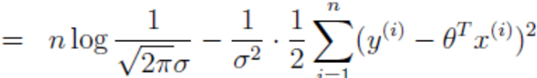
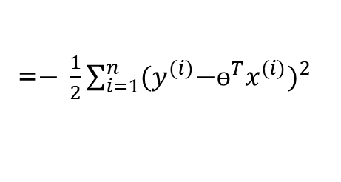
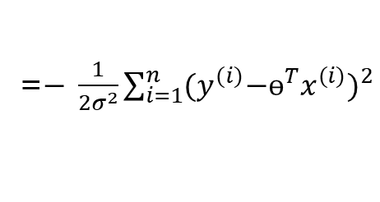
MLE – Linear Regression Model
Determine formula for 𝐿𝐿(𝜃)
Differentiate 𝐿𝐿(𝜃) w.r.t. (each) 𝜃
Solve
=$− \frac{1}{{2σ}^{2}}\sum_{i=1}^{n}{{{(y}^{(i)}{−ɵ^{T}x}^{(i)})}^{2}}$
=$− \frac{1}{2}\sum_{i=1}^{n}{{{(y}^{(i)}{−ɵ^{T}x}^{(i)})}^{2}}$

Slide 16
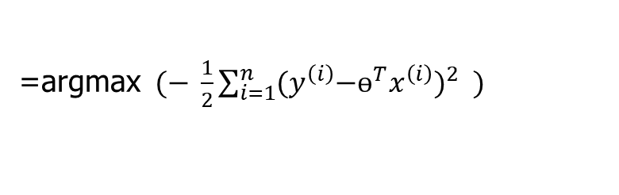
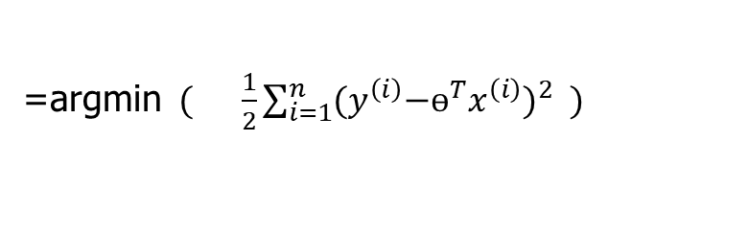
MLE – Linear Regression Model
Determine formula for 𝐿𝐿(𝜃)
Differentiate 𝐿𝐿(𝜃) w.r.t. (each) 𝜃
Solve
=$− \frac{1}{{2σ}^{2}}\sum_{i=1}^{n}{{{(y}^{(i)}{−ɵ^{T}x}^{(i)})}^{2}}$
=$− \frac{1}{2}\sum_{i=1}^{n}{{{(y}^{(i)}{−ɵ^{T}x}^{(i)})}^{2}}$
=argmax$(− \frac{1}{2}\sum_{i=1}^{n}{{{(y}^{\left(i\right)}{−ɵ^{T}x}^{\left(i\right)})}^{2}} )$
=argmin$( \frac{1}{2}\sum_{i=1}^{n}{{{(y}^{\left(i\right)}{−ɵ^{T}x}^{\left(i\right)})}^{2}} )$
With probabilistic assumptions on the data, least-squares regression corresponds to finding the MLE of θ

Slide 17
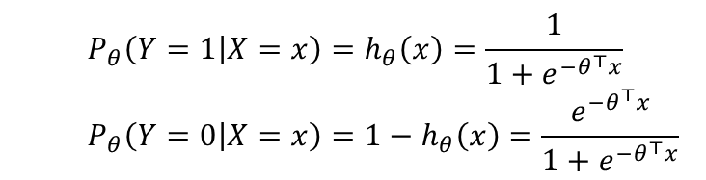

MLE – Logistic Regression
Determine formula for 𝐿𝐿(𝜃)
Differentiate 𝐿𝐿(𝜃) w.r.t. (each) 𝜃
Solve
$$LL\left(θ\right)=\log{\prod_{i=1}^{n}{P_{θ}\left(y^{(i)}|x^{\left(i\right)}\right)}}= \sum_{i=1}^{n}{\log{P_{θ}\left(y^{(i)}|x^{\left(i\right)}\right)}}$$
Mileage (in kmpl) | Car Price (in cr)
9.8 | High
9.12 | Low
9.5 | High
10 | Low
Bernoulli MLE Estimation
X₁,X₂,….,X_{n} where X_{i} ~ Ber(p). PMF of a Bernoulli
  $$P_{θ}\left(Y=1 | X=x\right)=h_{θ}\left(x\right)=\frac{1}{1+e^{{−θ}^{⊤}x}}$$
  $$P_{θ}\left(Y=0 | X=x\right)=1−h_{θ}\left(x\right)=\frac{e^{{−θ}^{⊤}x}}{1+e^{{−θ}^{⊤}x}}$$
MLE answers the question: For which parameter value does the observed data have the largest probability?

Slide 18
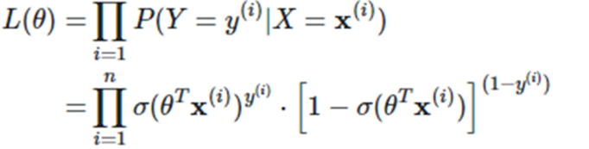
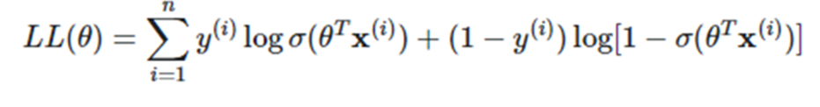
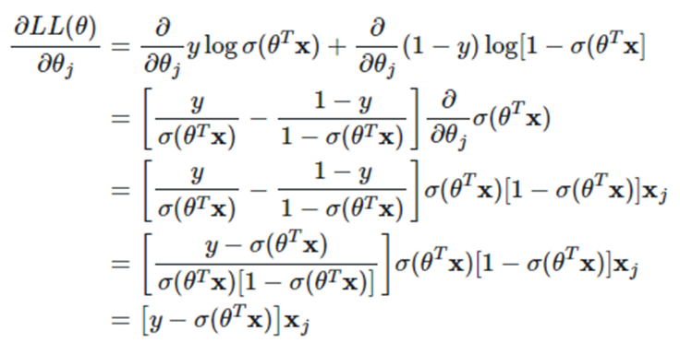
MLE – Logistic Regression
Determine formula for 𝐿𝐿(𝜃)
Differentiate 𝐿𝐿(𝜃) w.r.t. (each) 𝜃
Solve
MLE answers the question: For which parameter value does the observed data have the largest probability?

Slide 19

MLE – Logistic Regression
Determine formula for 𝐿𝐿(𝜃)
Differentiate 𝐿𝐿(𝜃) w.r.t. (each) 𝜃
Solve
MLE answers the question: For which parameter value does the observed data have the biggest probability?

Slide 20
MLE-Summary
Consider a sample of 𝑛 i.i.d. random variables 𝑋₁, 𝑋₂,…, 𝑋_{n}, drawn from a distribution 𝑓(𝑋_{i}|𝜃)
𝜃_{MLE} maximizes the likelihood of data, 𝐿 (𝜃) and 𝐿𝐿 (𝜃)

Slide 21
Additional Problems in MLE

Slide 22
MLE – Discrete - PMF
Determine formula for 𝐿𝐿(𝜃)
Differentiate 𝐿𝐿(𝜃) w.r.t. (each) 𝜃
Solve

Slide 23
MLE – Discrete - PMF
Determine formula for 𝐿𝐿(𝜃)
Differentiate 𝐿𝐿(𝜃) w.r.t. (each) 𝜃
Solve
X | P(X)
3 | (1-ɵ) / 3
0 | 2ɵ / 3
2 | 2(1-ɵ) / 3
1 | ɵ/ 3
3 | (1-ɵ) / 3
2 | 2(1-ɵ) / 3
1 | ɵ/ 3
0 | 2ɵ / 3
2 | 2(1-ɵ) / 3
1 | ɵ/ 3
L(ɵ) = P(X=3)*P(X=0)*P(X=2)*……..*P(X=1)
= ((1-ɵ) / 3)² * (2ɵ / 3)² * (2(1-ɵ) / 3)³ * (ɵ/ 3)³

Slide 24

MLE – Discrete - PMF
Determine formula for 𝐿𝐿(𝜃)
Differentiate 𝐿𝐿(𝜃) w.r.t. (each) 𝜃
Solve
L(ɵ) = P(X=3)*P(X=0)*P(X=2)*……..*P(X=1)
= ((1-ɵ) / 3)² * (2ɵ / 3)² * (2(1-ɵ) / 3)³ * (ɵ/ 3)³
LL(ɵ) = log [((1-ɵ) / 3)² * (2ɵ / 3)² * (2(1-ɵ) / 3)³ * (ɵ/ 3)³]
= log ((1-ɵ) / 3)² + log (2ɵ / 3)² + log (2(1-ɵ) / 3)³ * log(ɵ/ 3)³
= 2log ((1-ɵ) / 3) + 2log (2ɵ / 3) + 3 log (2(1-ɵ) / 3) + 3log(ɵ/ 3)
=2(log ((1-ɵ) -log 3) + 2(log (2ɵ)-log3) + 3( log (2(1-ɵ)) – log3) + 3(log(ɵ)-log 3)
Gradient ( LL(ɵ) ) = - $\frac{2}{\text{(1−ɵ)}}+ \frac{2}{\text{ɵ}}−\frac{3}{\text{(1−ɵ)}}+ \frac{3}{\text{ɵ}}$
= $\frac{−\text{5}\text{ɵ}\text{ + }5−\text{5}\text{ɵ}}{\text{(1−ɵ)ɵ}}$= $\frac{−10\text{ɵ + }5}{\text{(1−ɵ)ɵ}}$ = $0$➔ $\text{ɵ}$ = 0.5

Slide 25
Additional Exercise for Student’s Practice
Consider inputs x_{i} which are real valued attributes and the outputs y_{i} which are real
valued of the form , where f(x_{i}) is the true function and e_{i} is a random variable representing laplacian noise with PDF given by
Implementing a linear regression model of the form , and ,
find the maximum likelihood estimator of è. Comment on the loss function.

Slide 26

Additional Exercise for Student’s Practice
Determine formula for 𝐿𝐿(𝜃)
Differentiate 𝐿𝐿(𝜃) w.r.t. (each) 𝜃
Solve
L(ɵ) = L(ɵ) = ${\frac{1}{\text{2}\text{ɵ}} e}^{\frac{\text{−|}\text{y} \text{1 }\text{− }μ\text{|}}{\text{ɵ}}}$ *${\frac{1}{\text{2}\text{ɵ}} e}^{\frac{\text{−|}\text{y} \text{2 }\text{− }μ\text{|}}{\text{ɵ}}}$*${\frac{1}{\text{2}\text{ɵ}} e}^{\frac{\text{−|}\text{y}\text{ 3} \text{− }μ\text{|}}{\text{ɵ}}}$ *……..*${\frac{1}{\text{2}\text{ɵ}} e}^{\frac{\text{−|}\text{y} \text{n}\text{ − }μ\text{|}}{\text{ɵ}}}$
=${(\prod_{i=1}^{n}{{\frac{1}{\text{2}\text{ɵ}} e}^{\frac{\text{−|}\text{y} \text{i} \text{− }μ\text{|}}{\text{ɵ}}})} }^{}$
LL(ɵ) = ln $(\prod_{i=1}^{n}{{\frac{1}{\text{2}\text{ɵ}} e}^{\frac{\text{−|}\text{y} \text{i} \text{− }μ\text{|}}{\text{ɵ}}})}$ = - $\text{l}n (\text{2}\text{ɵ}) \sum_{i=1}^{n}{1}$ + $\sum_{i=1}^{n}{\text{l}n (e^{\frac{\text{−|}\text{y} \text{i} \text{− }μ\text{|}}{\text{ɵ}}})}$
= ${}_{\text{ɵ}}^{argmax}$- n $\text{l}n (\text{2}\text{ɵ})$ - $\sum_{i=1}^{n}{\frac{\text{|}\text{y} \text{i} \text{− }μ\text{|}}{\text{ɵ}}}$
= ${}_{\text{ɵ}}^{argmin}$n $\text{l}n (\text{2}\text{ɵ})$ + $\sum_{i=1}^{n}{\frac{\text{|}\text{y} \text{i} \text{− }μ\text{|}}{\text{ɵ}}}$
Gradient ( LL(ɵ) ) = $\frac{n}{\text{(ɵ)}} −\frac{\sum_{i=1}^{n}{\text{|}\text{y} \text{i} \text{− }μ\text{|}}}{\text{(ɵ}2\text{)}}$= $0$
$\frac{n}{\text{(ɵ)}}=\frac{\sum_{i=1}^{n}{\text{|}\text{y} \text{i} \text{− }μ\text{|}}}{\text{(ɵ}2\text{)}}$
$\text{ɵ}=\frac{\sum_{i=1}^{n}{\text{|}\text{y} \text{i} \text{− }μ\text{|}}}{\text{n}}$ Instead of MSE, MAE is the maximum likelihood hypothesis. So MAE is appropriate for the loss function

Slide 27
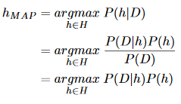
Maximum A Posteriori (MAP) Analysis
Determine prior probability
Find the posterior probability for every distinct prior
Choose the posterior with highest h_{MAP} value
𝜃_{𝑀𝐴𝑃} = arg max 𝑓(𝜃|𝑋₁, 𝑋₂, … , 𝑋_{𝑛})
Brute Force MAP Hypothesis
Maximum a Posteriori (MAP) Estimator of 𝜃 is the value of 𝜃 that maximizes the posterior distribution of 𝜃.
Best hypothesis ≈ most probable hypothesis

Slide 28
Maximum A Posteriori Estimation (MAP)
Find the prior probability
Derive the posterior probability
Differentiate posterior w.r.t. (each) 𝜃
Solve
Maximum a Posteriori (MAP) Estimator of 𝜃 is the value of 𝜃 that maximizes the posterior distribution of 𝜃.
Best hypothesis ≈ most probable hypothesis

Slide 29
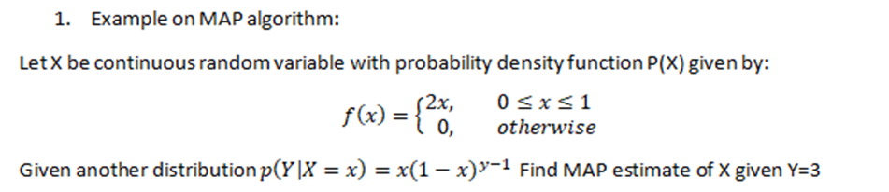
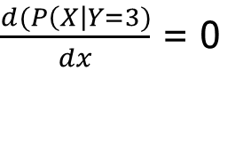


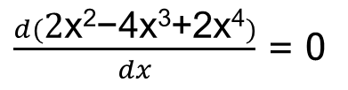
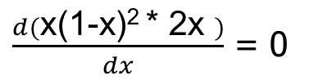
Example :
h _{MAP} = P( X | Y=3)
= P(Y=3 | X) * P(X)
= x(1-x)^{y-1} * 2x
To find the parameter x , differentiate the function & equate to zero.
$\frac{d(P\left(X\right|Y=3)}{dx}$ = 0
$\frac{d(\text{2}\text{x}\text{2}\text{−}\text{4}\text{x}\text{3}\text{+2}\text{x}\text{4})}{dx}$ = 0
$\text{4}\text{x}\text{−12}\text{x}\text{2}\text{+8}\text{x}3$= 0
$\frac{d(\text{x}\text{(1−}\text{x}\text{)2 ∗ 2}\text{x} )}{dx}$ = 0
$x$ = {0, 0.5, 1}

Slide 30
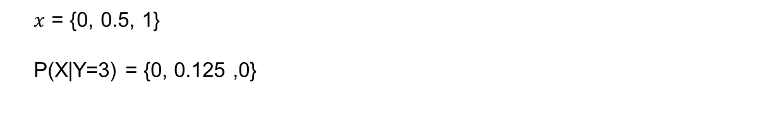
Example :
h _{MAP} = P( X | Y=3)
= P(Y=3 | X) * P(X)
= x(1-x)^{y-1} * 2x
$x$ = {0, 0.5, 1}
P(X|Y=3) = {0, 0.125 ,0}

Slide 31
Most Probable Classification of New Instances
So far we’ve sought the most probable hypothesis given the data D (i.e., h_{MAP})
Given new instance x, what is its most probable classification?
  h_{MAP}(x) is not the most probable classification!
  What’s most probable classification of x?
Consider:
Three possible hypotheses:
P(h₁|D) = .4, P(h₂|D) = .3, P(h₃|D) = .3
Given new instance x, classification given by above 3 hypotheses is
h₁(x) = +, h₂(x) = −, h₃(x) = −
May be the classification for X is +
and

Slide 32
ML setting
Bayesian Analysis
  start with some belief about the system, called a prior.
  Then we obtain some data and use it to update our belief.
  The outcome is called a posterior.
  Should we obtain even more data, the old posterior becomes a new prior and the cycle repeats.
  P(h | D) a posterior determines the class label
  MLE and MAP are the same if the prior is uniform
  This forms the basis for Naïve Bayes classifier → More on this will be discussed in later part of this module

Slide 33

Bayes’ Optimal Classifier
The most probable classification of the new instance is obtained by combining the predictions of all hypotheses, weighted by their posterior probabilities.
v_{j} from some set V, then the probability P(v_{j} l D) that the correct classification for the new instance is v_{j} is:
The optimal classification of the new instance is the value vj for which P(v_{j} l D) is maximum

Slide 34

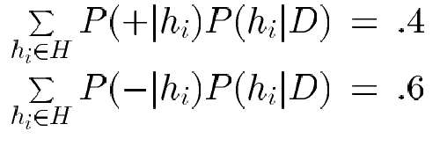

Example 1 : Bayes Optimal Classifier
Bayes optimal classification:
Example:
P(h₁|D) = .4, P(−|h₁) = 0, P(+|h₁) = 1
P(h₂|D) = .3, P(−|h₂) = 1, P(+|h₂) = 0
P(h₃|D) = .3, P(−|h₃) = 1, P(+|h₃) = 0
therefore
and

Slide 35
Gibbs Classifier
Bayes optimal classifier provides best result, but can be expensive if many hypotheses.
Gibbs algorithm:
  Choose one hypothesis at random, according to posterior prob. Distribution over h , P(h|D)
  Use this h to classify new instance
Surprising fact: under certain conditions, the expected misclassification error for the Gibbs algorithm is at most twice the expected error of the Bayes optimal classifier
E[error_{Gibbs}] ≤ 2E [error_{BayesOptional}]
Suppose correct, uniform prior distribution over H, then
  Pick any hypothesis from Version space, with uniform probability
  Its expected error no worse than twice Bayes optimal

Slide 36
Parameter Estimation in ML - Summary
Assumption: Data are__
  IID samples: X₁…X_{n}
  where all X_{i} are independent and have the same distribution.
  Either same PMF (discrete) or same PDF (continuous)
f (X | 𝜃)
  Likelihood of different values of X depends on the values of our parameters 𝜃
  f( ) is either PDF or PMF
Parameters : ($θ$₀, $θ$₁, $θ$₂)
Find $θ=(θ\text{0}\text{, }θ\text{1}\text{, }θ\text{2})$ from the data X_{i}
  Maximum Likelihood Estimation (MLE)
    select that parameters 𝜃 that make the observed data the most likely
  Maximum A Posteriori (MAP)
    choose the parameters 𝜃 that is the most likely, given the data
f (X₁ , X₂ .....X_{n} | $θ$)
f ($θ$ | X₁ , X₂ .....X_{n})
If the sample is large, MLE will yield an excellent estimator of θ
When no prior information is available, all hypothesis are equally likely i.e. p(hi) = p(hj)

Slide 37
Naïve Bayes Classifier

Slide 38
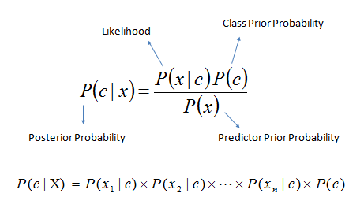
Refresh from Pre-Mid Term
Decision Theory: Interpretation Model Building
Generative
x₂
x₁
Sky | AirTemp | Humidity | Wind | Forecast | Enjoy Sport?
Sunny | Warm | Normal | Strong | Same | Yes
Sunny | Warm | High | Strong | Same | No
Rainy | Cold | High | Strong | Change | No
Sunny | Warm | Normal | Breeze | Same | Yes
Sunny | Hot | Normal | Breeze | Same | No
Rainy | Cold | High | Strong | Change | No
Sunny | Warm | High | Strong | Change | Yes
Rainy | Warm | Normal | Breeze | Same | Yes
Known as generative models, because by sampling from them it is possible to generate synthetic data points in the input space.
Eg., Gaussians, Naïve Bayes, Mixtures of multinomials , Mixtures of Gaussians, Bayesian networks

Slide 39
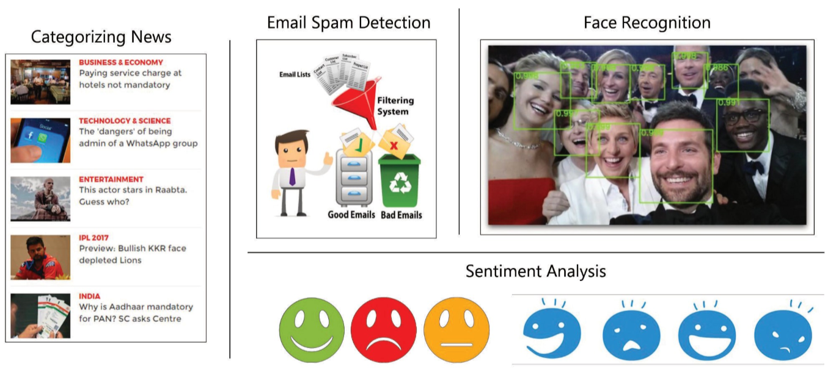
Naïve Bayes Classifier - Applications

Slide 40
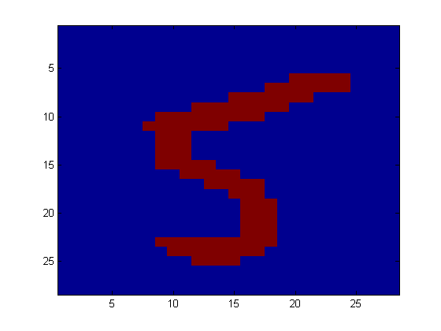
Example: Digit Recognition
X₁,…,X_{n} ∈ {0,1} (Black vs. White pixels)
Y ∈ {5,6} (predict whether a digit is a 5 or a 6)
Classifier

Slide 41
Generative models for classification
For binary classification the denominator is given by
p(x) = p(x|y = 1)p(y = 1) + p(x|y = 0)p(y = 0)
if we’re calculating p(y|x) in order to make a prediction, then we don’t actually need to calculate the denominator, since

Slide 42
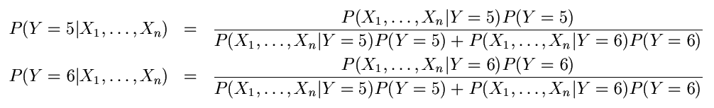
The Bayes Classifier
To classify, we’ll simply compute these two probabilities and predict based on which one is greater

Slide 43
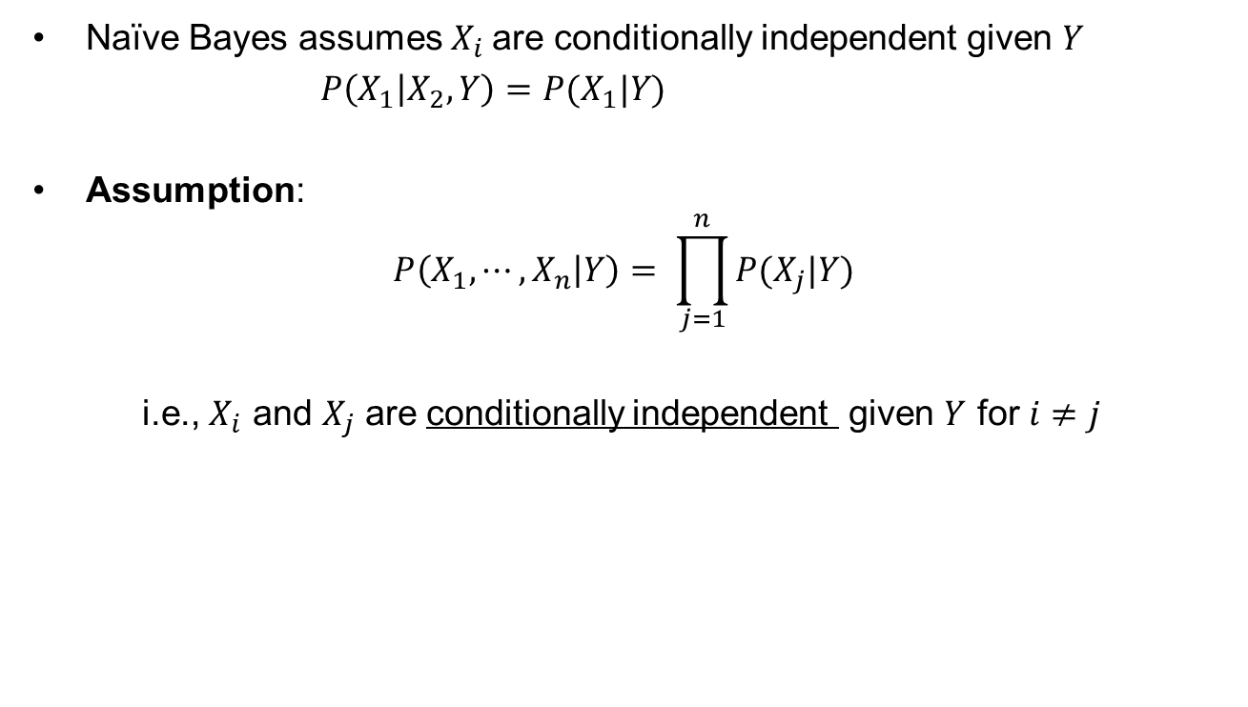
Naïve Bayes conditional Independence assumption
Naïve Bayes assumes $X_{i}$are conditionally independent given $Y$
$P\left(X_{1} | X_{2}, Y\right)=P(X_{1}|Y)$
Assumption:
$$P\left(X_{1}, ⋯,X_{n} | Y\right)= \prod_{j=1}^{n}{P(X_{j}|Y)}$$
i.e., $X_{i}$ and $X_{j}$ are conditionally independent given $Y$ for $i≠j$

Slide 44
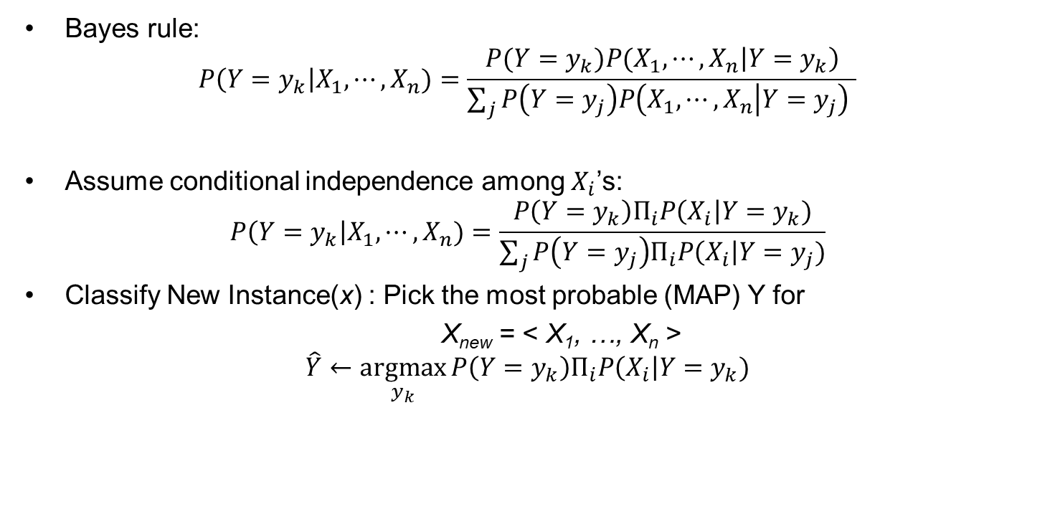
Naïve Bayes classifier: Prediction
Goal of learning P(Y|X) where X = <X₁,…, X_{n}>
Bayes rule:
$$P\left(Y=y_{k}\right|X_{1}, ⋯,X_{n})=\frac{{P(Y=y_{k})P(X_{1},⋯,X}_{n}\left|Y=y_{k}\right)}{\sum_{j}{P\left(Y=y_{j}\right)P\left(X_{1},⋯, X_{n} | Y=y_{j}\right) }}$$
Assume conditional independence among $X_{i}$’s:
$$P\left(Y=y_{k}\right|X_{1}, ⋯,X_{n})=\frac{P\left(Y=y_{k}\right)Π_{i}P\left(X_{i}\right|Y=y_{k})}{\sum_{j}{P\left(Y=y_{j}\right)Π_{i}P\left(X_{i}\right|Y=y_{j})}}$$
Classify New Instance(x) : Pick the most probable (MAP) Y for
X_{new} = < X₁, …, X_{n} >
$$\hat{Y}←\underset{y_{k}}{argmax}{P\left(Y=y_{k}\right)Π_{i}P\left(X_{i}\right|Y=y_{k})}$$
Prior
Likelihood

Slide 45
Example: Play Tennis
P(X|Y)$\sim Multinom\left(π,n\right)$ $→ Multinomial NB$ (X_{i} – multinomial)
P($Y$) ~ Ber(p)
Sky | AirTemp | Humidity | Wind | Forecast | Enjoy Sport?
Sunny | Warm | Normal | Strong | Same | Yes
Sunny | Warm | High | Strong | Same | No
Rainy | Cold | High | Strong | Change | No
Sunny | Warm | Normal | Breeze | Same | Yes
Sunny | Hot | Normal | Breeze | Same | No
Rainy | Cold | High | Strong | Change | No
Sunny | Warm | High | Strong | Change | Yes
Rainy | Warm | Normal | Breeze | Same | Yes
$$\hat{Y}←\underset{y_{k}}{argmax}{P\left(Y=y_{k}\right)Π_{i}P\left(X_{i}\right|Y=y_{k})}$$

Slide 46
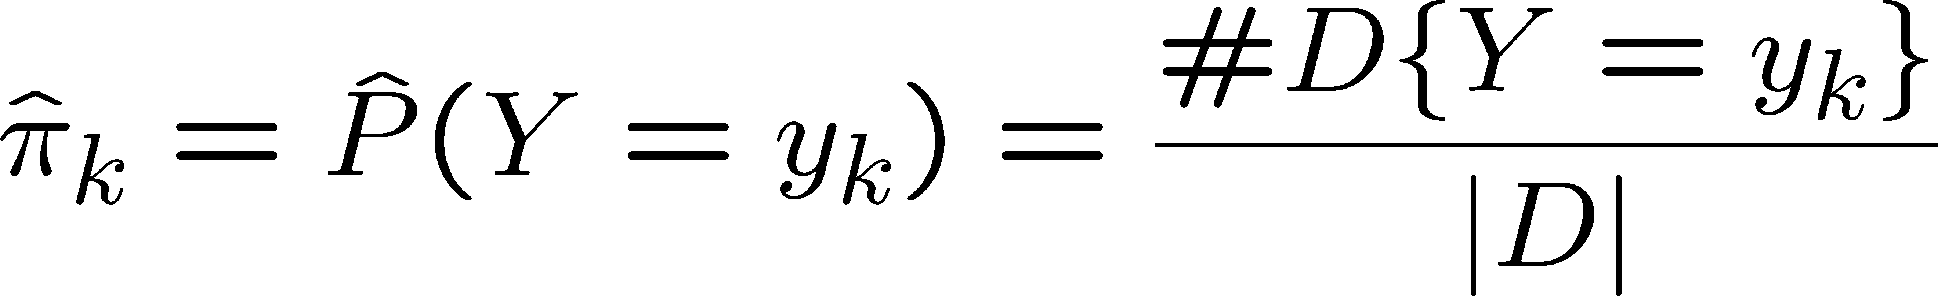
Example: Play Tennis – Learning Phase
  Look up tables
Maximum likelihood estimates (MLE’s):
Sky | Play=Yes | Play=No
Sunny | 3/3 | 2/4
Rainy | 0/3 | 2/4
Number of items in dataset D for which Y=y_{k}
Wind | Play=Yes | Play=No
Strong | 2/3 | 3/4
Breeze | 1/3 | 1/4
Sky | AirTemp | Humidity | Wind | Forecast | Enjoy Sport?
Sunny | Warm | Normal | Strong | Same | Yes
Sunny | Warm | High | Strong | Same | No
Rainy | Cold | High | Strong | Change | No
Sunny | Warm | Normal | Breeze | Same | Yes
Sunny | Hot | Normal | Breeze | Same | No
Rainy | Cold | High | Strong | Change | No
Sunny | Warm | High | Strong | Change | Yes
Rainy | Warm | Normal | Breeze | Same | Yes
AirTemp | Play=Yes | Play=No
Hot | 0/3 | 1/4
Warm | 3/3 | 1/4
Cold | 0/3 | 2/4
Forecast | Play=Yes | Play=No
Same | 2/3 | 2/4
Change | 1/3 | 2/4
Humidity | Play=Yes | Play=No
High | 1/3 | 3/4
Normal | 2/3 | 1/4

Slide 47
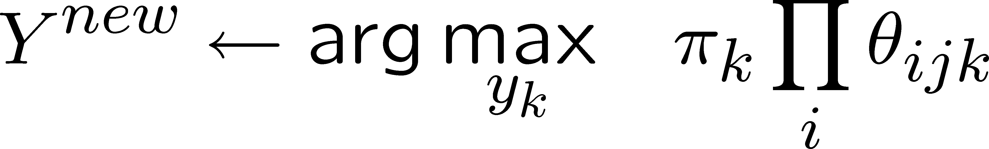
Example: Play Tennis - Testing Phase
  MAP rule
P(Enjoy=Yes | X) = P(X | Enjoy=Yes). P(Enjoy=Yes) / P(X)
= P(X | Enjoy=Yes). P(Enjoy=Yes)
= P(X | Enjoy=Yes). (3/7)
= P(Sunny | Enjoy=Yes). P(Warm | Enjoy=Yes). P(Normal | Enjoy=Yes). P(Strong | Enjoy=Yes). P(Change | Enjoy=Yes).(3/7)
= (3/3) . (3/3) . (2/3) . (2/3) . (1/3) . (3/7)
=0.0635
P(Enjoy=Yes | X) > P(Enjoy=No | X) → EnjoySport = Yes
P(Enjoy=No | X) = P(X | Enjoy=No). P(Enjoy=No) / P(X)
= P(X | Enjoy=No). P(Enjoy=No)
= P(X | Enjoy=No). (4/7)
= P(Sunny | Enjoy=No). P(Warm | Enjoy=No). P(Normal | Enjoy=No). P(Strong | Enjoy=No). P(Change | Enjoy=No). (4/7)
= (2/4) . (1/4) . (1/4) . (3/4) . (2/4) . (4/7)
= 0.006696
Sky | AirTemp | Humidity | Wind | Forecast | Enjoy Sport?
Sunny | Warm | Normal | Strong | Same | Yes
Sunny | Warm | High | Strong | Same | No
Rainy | Cold | High | Strong | Change | No
Sunny | Warm | Normal | Breeze | Same | Yes
Sunny | Hot | Normal | Breeze | Same | No
Rainy | Cold | High | Strong | Change | No
Sunny | Warm | High | Strong | Change | Yes
Sunny | Warm | Normal | Strong | Change | ????
Rainy | Warm | Normal | Breeze | Same | ????

Slide 48
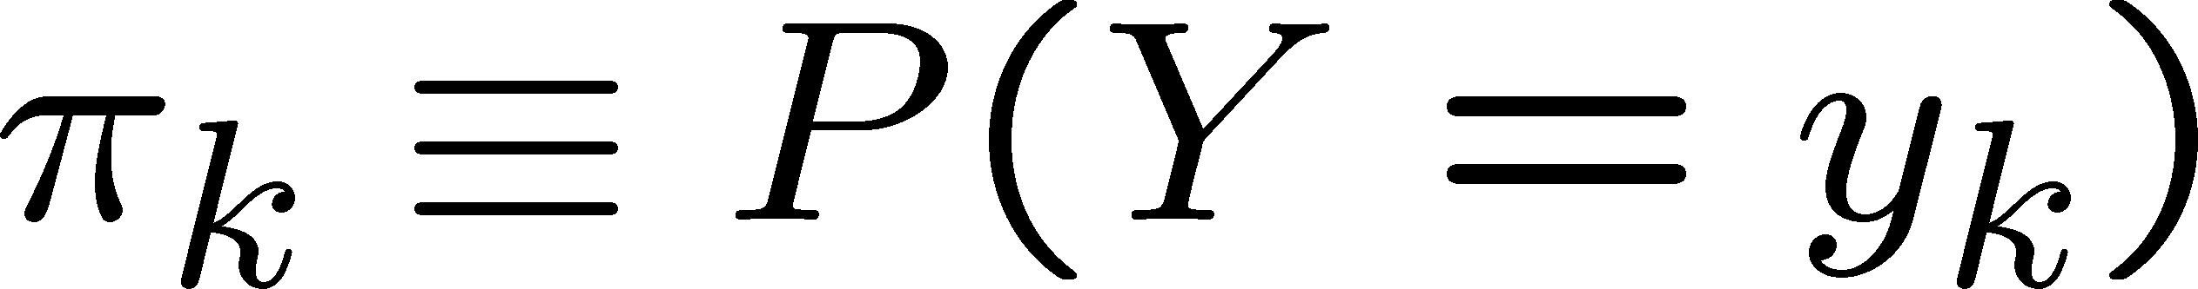
Naïve Bayes Algorithm – discrete X_{i}
Train Naïve Bayes (examples) for each* value y_{k}
estimate
for each* value x_{ij} of each attribute X_{i}
estimate
Classify (X^{new})

Slide 49
Example: Play Tennis
P(Enjoy=Yes | X) = P(X | Enjoy=Yes). P(Enjoy=Yes) / P(X)
= P(X | Enjoy=Yes). P(Enjoy=Yes)
= P(X | Enjoy=Yes). (3/7)
= P(Rainy | Enjoy=Yes). P(Warm | Enjoy=Yes). P(Normal | Enjoy=Yes). P(Breeze | Enjoy=Yes). P(Same | Enjoy=Yes).(3/7)
= (0/3) . (3/3) . (2/3) . (1/3) . (2/3) . (3/7)
P(Enjoy=No | X) = P(X | Enjoy=No). P(Enjoy=No) / P(X)
= P(X | Enjoy=No). P(Enjoy=No)
= P(X | Enjoy=No). (4/7)
= P(Rainy | Enjoy=No). P(Warm | Enjoy=No). P(Normal | Enjoy=No). P(Breeze | Enjoy=No). P(Same | Enjoy=No). (4/7)
= (2/4) . (1/4) . (1/4) . (1/4) . (2/4) . (4/7)
Sky | Enjoy Sport?
Sunny | Yes
Sunny | No
Rainy | No
Sunny | Yes
Sunny | No
Rainy | No
Sunny | Yes
Rainy | ????
AirTemp | Humidity | Wind | Forecast | Enjoy Sport?
Warm | Normal | Strong | Same | Yes
Warm | High | Strong | Same | No
Cold | High | Strong | Change | No
Warm | Normal | Breeze | Same | Yes
Hot | Normal | Breeze | Same | No
Cold | High | Strong | Change | No
Warm | High | Strong | Change | Yes
Warm | Normal | Breeze | Same | ????

Slide 50
Laplace Smoothing

Slide 51
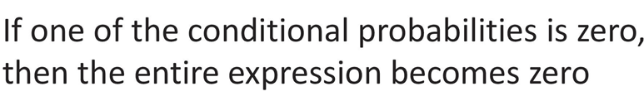
Smoothing
Technique for smoothing categorical data.
A small-sample correction, or pseudo-count, will be incorporated in every probability estimate.
No probability will be zero.

Slide 52
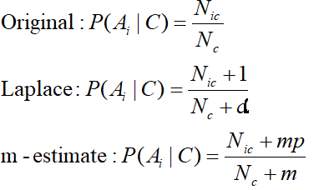
Smoothing
Probability estimation:
d: number of distinct values of an attribute
N_{c}: number of instances in the class
N_{ic}: number of instances having attribute value A_{i} in class c
p: prior probability of the class
m: constant called the equivalent sample size, which determines how heavily to weight p relative to the observed data
Bayesian approach

Slide 53

Example: Play Tennis
P(Enjoy=Yes | X) = P(X | Enjoy=Yes). P(Enjoy=Yes) / P(X)
= P(X | Enjoy=Yes). P(Enjoy=Yes)
= P(X | Enjoy=Yes). (3/7)
= P(Rainy | Enjoy=Yes). P(Warm | Enjoy=Yes). P(Normal | Enjoy=Yes). P(Breeze | Enjoy=Yes). P(Same | Enjoy=Yes).(3/7)
= (0+1/3+2) . (3 +1/3+3) . (2+1/3+2) . (1+1/3+2) . (2+1/3+2) . (3/7)
For Laplace smoothing α = 1
P(Enjoy=No | X) = P(X | Enjoy=No). P(Enjoy=No) / P(X)
= P(X | Enjoy=No). P(Enjoy=No)
= P(X | Enjoy=No). (4/7)
= P(Rainy | Enjoy=No). P(Warm | Enjoy=No). P(Normal | Enjoy=No). P(Breeze | Enjoy=No). P(Same | Enjoy=No). (4/7)
= (2+1/4+2) . (1+1/4+3) . (1+1/4+2) . (1+1/4+2) . (2+1/4+2) . (4/7)
AirTemp | Humidity | Wind | Forecast | Enjoy Sport?
Warm | Normal | Strong | Same | Yes
Warm | High | Strong | Same | No
Cold | High | Strong | Change | No
Warm | Normal | Breeze | Same | Yes
Hot | Normal | Breeze | Same | No
Cold | High | Strong | Change | No
Warm | High | Strong | Change | Yes
Warm | Normal | Breeze | Same | ????

Slide 54
Example: Play Tennis
P(Enjoy=Yes | X) = P(X | Enjoy=Yes). P(Enjoy=Yes) / P(X)
= P(X | Enjoy=Yes). P(Enjoy=Yes)
= P(X | Enjoy=Yes). (3/7)
= P(Rainy | Enjoy=Yes). P(Warm | Enjoy=Yes). P(Normal | Enjoy=Yes). P(Breeze | Enjoy=Yes). P(Same | Enjoy=Yes).(3/7)
= (1/5) . (4/6) . (3/5) . (2/5) . (3/5) . (3/7)
=0.00822
P(Enjoy=Yes | X) > P(Enjoy=No | X) → EnjoySport = Yes
P(Enjoy=No | X) = P(X | Enjoy=No). P(Enjoy=No) / P(X)
= P(X | Enjoy=No). P(Enjoy=No)
= P(X | Enjoy=No). (4/7)
= P(Rainy | Enjoy=No). P(Warm | Enjoy=No). P(Normal | Enjoy=No). P(Breeze | Enjoy=No). P(Same | Enjoy=No). (4/7)
= (3/6) . (2/7) . (2/6) . (2/6) . (3/6) . (4/7)
= 0.00453
Sky | AirTemp | Humidity | Wind | Forecast | Enjoy Sport?
Sunny | Warm | Normal | Strong | Same | Yes
Sunny | Warm | High | Strong | Same | No
Rainy | Cold | High | Strong | Change | No
Sunny | Warm | Normal | Breeze | Same | Yes
Sunny | Hot | Normal | Breeze | Same | No
Rainy | Cold | High | Strong | Change | No
Sunny | Warm | High | Strong | Change | Yes
Sunny | Warm | Normal | Strong | Change | ????
Rainy | Warm | Normal | Breeze | Same | ????

Slide 55
Naïve Bayes: Continuous Features
$X_{i}$ can be continuous
Naïve Bayes classifier:
$$Y=\arg{\max_{y}{P\left(Y=y\right)\prod_{i}{P(X_{i}|Y=y)}}}$$
Assumption: $P(X_{i}|Y)$has a Gaussian distribution

Slide 56

The Gaussian Probability Distribution
It is a continuous distribution with pdf:
$$ = mean of distribution
$σ^{2}$ = variance of distribution
$x$ is a continuous variable ($−∞≤x≤∞)$
$$p\left(x\right)=\frac{1}{σ\sqrt{2π}}e^{−\frac{{\left(x −μ\right)}^{2}}{2 σ^{2}}}$$
x

Slide 57
Continuous Features : learning and prediction
For each target value Y_{k} (MLE estimate)
P($Y=y_{k}$) ← No. of instances with Y_{k} class/No. of Total instances
For each attribute value X_{i} estimate $P \left(X_{i}\right|Y=y_{k})$
  class conditional mean , variance
Classify New Instance(x)
Pick the most probable (MAP) Y
$$\hat{Y}←\underset{y_{k}}{argmax}{P\left(Y=y_{k}\right)Π_{i}P\left(X_{i}\right|Y=y_{k})}$$

Slide 58
Continuous Features : learning
$P(X_{i}|Y)$is Gaussian
Training: estimate mean and standard deviation
  $μ_{i}=E\left[X_{i} | Y=y\right]$
  $σ_{i}^{2}=E\left[{\left(X_{i}−μ_{i}\right)}^{2} | Y=y\right]$
$$X_{1}$$ | $$X_{2}$$ | $$X_{3}$$ | $$Y$$
$$2$$ | $$3$$ | $$1$$ | $$1$$
$$−1.2$$ | $$2$$ | $$0.4$$ | $$1$$
$$1.2$$ | $$0.3$$ | $$0$$ | $$0$$
$$2.2$$ | $$1.1$$ | $$0$$ | $$1$$

Slide 59
Continuous Features : learning
$$X_{1}$$ | $$X_{2}$$ | $$X_{3}$$ | $$Y$$
$$2$$ | $$3$$ | $$1$$ | $$1$$
$$−1.2$$ | $$2$$ | $$0.4$$ | $$1$$
$$1.2$$ | $$0.3$$ | $$0$$ | $$0$$
$$2.2$$ | $$1.1$$ | $$0$$ | $$1$$
  $μ_{i}=E\left[X_{i} | Y=y\right]$
  $σ_{i}^{2}=E\left[{\left(X_{i}−μ_{i}\right)}^{2} | Y=y\right]$
  $μ_{1}=E\left[X_{1} | Y=1\right]=\frac{2+\left(−1.2\right)+2.2}{3}=1$
  $σ_{1}^{2}=E\left[\left(X_{1}−μ_{1}\right) | Y=1\right]=$
  $$\frac{{{\left(2−1\right)}^{2}+{\left(−1.2 −1\right)}^{2}+\left(2.2 −1\right)}^{2}}{3}=2.43$$

Slide 60
Example: Play Tennis
P(X|Y) ~ N(μ, σ²) $→ GaussianNB$ (X_{i} – real valued)
P(Enjoy=Yes | X) = P(X | Enjoy=Yes). P(Enjoy=Yes) / P(X)
= P(X | Enjoy=Yes). P(Enjoy=Yes)
= P(X | Enjoy=Yes). (3/7)
= P(Rainy | Enjoy=Yes). P(Warm | Enjoy=Yes). P(60 | Enjoy=Yes). P(Breeze | Enjoy=Yes). P(Same | Enjoy=Yes).(3/7)
= (1/3) . (3/3) . 0.15*10⁻⁹⁵ . (1/3) . (2/3) . (3/7)
P(Enjoy=No | X) = P(X | Enjoy=No). P(Enjoy=No) / P(X)
= P(X | Enjoy=No). P(Enjoy=No)
= P(X | Enjoy=No). (4/7)
= P(Rainy | Enjoy=No). P(Warm | Enjoy=No). P(60 | Enjoy=No). P(Breeze | Enjoy=No). P(Same | Enjoy=No). (4/7)
= (2/4) . (1/4) . 0.02 . (1/4) . (2/4) . (4/7)
Humidity | Enjoy Sport?
85 | Yes
80 | No
70 | No
83 | Yes
90 | No
50 | No
85 | Yes
60 | ????
AirTemp | Sky | Wind | Forecast | Enjoy Sport?
Warm | Sunny | Strong | Same | Yes
Warm | Sunny | Strong | Same | No
Cold | Rainy | Strong | Change | No
Warm | Rainy | Breeze | Same | Yes
Hot | Sunny | Breeze | Same | No
Cold | Rainy | Strong | Change | No
Warm | Sunny | Strong | Change | Yes
Warm | Rainy | Breeze | Same | ????
  $μ_{i}=E\left[X_{i} | Y=yes\right]$ = 84.33
  $σ_{i}^{2}=E\left[{\left(X_{i}−μ_{i}\right)}^{2} | Y=yes\right]$ = 1.15
  $μ_{i}=E\left[X_{i} | Y=no\right]$ = 72.5
  $σ_{i}^{2}=E\left[{\left(X_{i}−μ_{i}\right)}^{2} | Y=no\right]$ = 17.08

Slide 61
Additional Exercises – For Student’s Practice
As a part of efforts to improve students’ performance in the exams, you have been given the data showing number of study hours spent by students, their gender and their final results as pass or fail. Using this sample dataset, apply Naïve Bayes classification technique, to classify the below test case:
{No of study hours = 3.5, Gender=”male”} either as “Pass”, or “Fail”.
No of study hours | Gender | Final result
4.5 | Male | Pass
7 | Female | Pass
2 | Male | Fail
4 | Female | Fail
2.5 | Male | Fail
3 | Female | Fail
8.3 | Male | Fail
8 | Female | Pass
9 | Male | Pass
Tip: P(X|Y) ~ N(μ, σ²) $→ GaussianNB$ (X_{i} – real valued)

Slide 62
Additional Exercises – For Student’s Practice
P(Pass | X) = P(X | Pass). P(Pass) / P(X)
= P(X | Pass). P(Pass)
= P(X | Pass). (0.44)
= P(Male | Pass). P(3.5 | Pass).(0.44)
= (2/4). 0.1056 . (0.44) = 0.0235
P(Fail | X) = P(X | Fail). P(Fail) / P(X)
= P(X | Fail). P(Fail)
= P(X | Fail). (0.56)
= P(Male | Fail). P(3.5 | Fail).(0.56)
= (3/5). 0.1846 . (0.56) = 0.0615
No of study hours | Gender | Final result
4.5 | Male | Pass
7 | Female | Pass
2 | Male | Fail
4 | Female | Fail
2.5 | Male | Fail
3 | Female | Fail
8.3 | Male | Fail
8 | Female | Pass
9 | Male | Pass

Slide 63
Text Classification using Naive Bayes Classifier

Slide 64
The Bag of Words Representation
it | 6
I | 5
the | 4
to | 3
and | 3
seen | 2
yet | 1
would | 1
whimsical | 1
times | 1
sweet | 1
satirical | 1
adventure | 1
genre | 1
fairy | 1
humor | 1
have | 1
great | 1
… | …
I love this movie! It's sweet, but with satirical humor. The dialogue is great and the adventure scenes are fun... It manages to be whimsical and romantic while laughing at the conventions of the fairy tale genre. I would recommend it to just about anyone. I've seen it several times, and I'm always happy to see it again whenever I have a friend who hasn't seen it yet!
fairy
it and
always love_{to} ^{it} whimsical it
I
seen
are
anyone
friend
happy
dialogue
adventure
recommend
satirical
_{who}sweet of _{movie}
it I
it ^{I} but ^{to} romantic
several
yet it
again
the
humor
the
seen
would
to scenes I
the manages
fun ^{the} times _{and}
I
and
about
whenever
have
while
conventions with

Slide 65
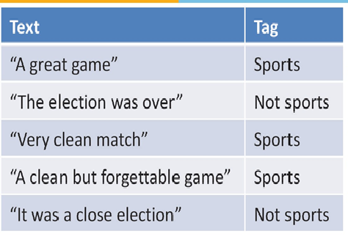
Example : Multinomial model :
Which Tag sentence “ A very close game” belong to?
P(Sports=Yes) = 3/5
P(Sports=No) = 2/5
P(A | Sports=Yes) = 2/11
P(A | Sports=No) = 1/9
P(Sports=Yes | X) = P(X | Sports=Yes). P(Sports=Yes) / P(X)
= P(X | Sports=Yes). (3/5)
= P(A| Sports=Yes). P(Very | Sports=Yes). P(Close | Sports=Yes). P(Game | Sports=Yes). (3/5)
= (2/11) . (1/11) . (0/11) . (2/11) . (3/5)
A | Great | Game | The | Election | Was | Over | Very | Clean | Match | But | Forgettable | It | Close | Sports or Not Sports
1 | 1 | 1 |  |  |  |  |  |  |  |  |  |  |  | 1
 |  |  | 1 | 1 | 1 | 1 |  |  |  |  |  |  |  | 0
 |  |  |  |  |  |  | 1 | 1 | 1 |  |  |  |  | 1
1 |  | 1 |  |  |  |  |  | 1 |  | 1 | 1 |  |  | 1
1 |  |  |  | 1 | 1 |  |  |  |  |  |  | 1 | 1 | 0
1 |  | 1 |  |  |  |  | 1 |  |  |  |  |  | 1 | ????

Slide 66
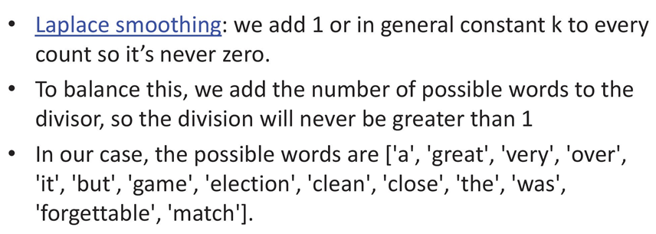
Laplace Smoothing
In our example
we add 1 to every probability, therefore the probability, such as P(close | sports), will never be 0.

Slide 67
Example : Multinomial model :
Which Tag sentence “ A very close game” belong to?
P(Sports=Yes) = 3/5
P(Sports=No) = 2/5
P(A | Sports=Yes) = 2/11
P(A | Sports=No) = 1/9
P(Sports=Yes | X) = P(X | Sports=Yes). P(Sports=Yes) / P(X)
= P(X | Sports=Yes). (3/5)
= P(A| Sports=Yes). P(Very | Sports=Yes). P(Close | Sports=Yes). P(Game | Sports=Yes). (3/5)
= (2/11) . (1/11) . (0/11) . (2/11) . (3/5)
= (2+1/11+14) . (1+1/11+14) . (0+1/11+14) . (2+1/11+14) . (3/5) (3+14/5+28)
= 0.00002765 =0.00002396
A | Great | Game | The | Election | Was | Over | Very | Clean | Match | But | Forgettable | It | Close | Sports or Not Sports
1 | 1 | 1 |  |  |  |  |  |  |  |  |  |  |  | 1
 |  |  | 1 | 1 | 1 | 1 |  |  |  |  |  |  |  | 0
 |  |  |  |  |  |  | 1 | 1 | 1 |  |  |  |  | 1
1 |  | 1 |  |  |  |  |  | 1 |  | 1 | 1 |  |  | 1
1 |  |  |  | 1 | 1 |  |  |  |  |  |  | 1 | 1 | 0
1 |  | 1 |  |  |  |  | 1 |  |  |  |  |  | 1 | ????

Slide 68
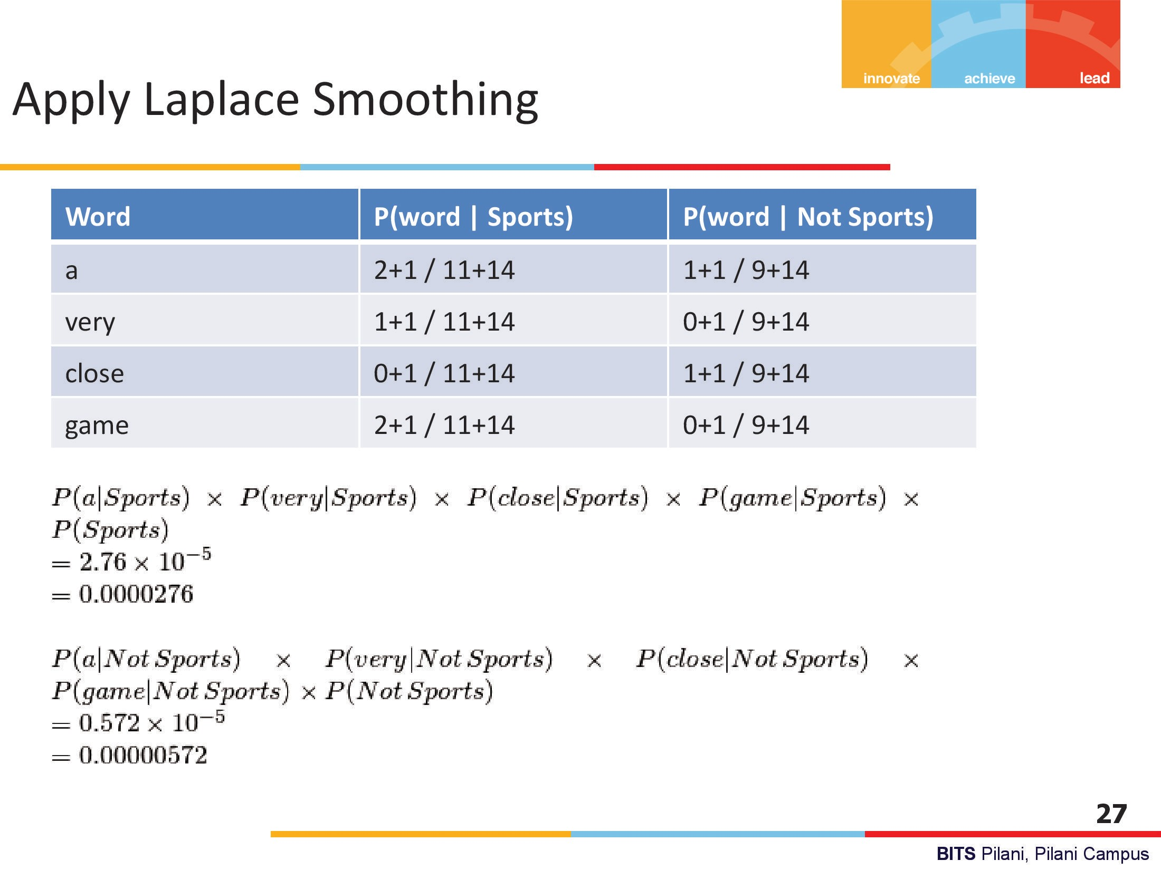

Slide 69
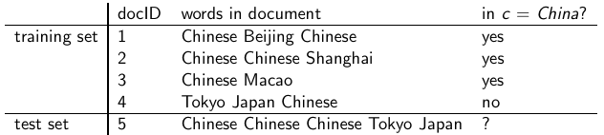
Example 2: Multinomial model
N_{yes} (W=Chinese) = 5, N_{No} (W=Chinese) = 1,
|v| = 6 = {Chinese, Beijing, Shanghai, Macao, Tokyo Japan}
No of features (words) in Yes class = 8
No of features (words) in No class = 3
Source Credit : https://nlp.stanford.edu/IR-book
69

Slide 70

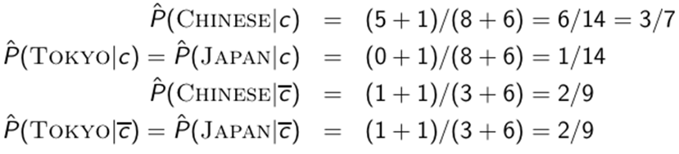
Example 2
Source Credit : https://nlp.stanford.edu/IR-book
70

Slide 71

Example 2
u-each word in test document
Source Credit : https://nlp.stanford.edu/IR-book

Slide 72
Naïve Bayes classifier: Summary Model
Model: joint probability distribution given by
  $P\left(X,Y\right)=P\left(Y\right) P\left(X | Y\right)$
  $P\left(X=X_{1}, ⋯,X_{n},Y=y_{k}\right)=P\left(Y=y_{k}\right) P(X=X_{1}, ⋯,X_{n}|Y=y_{k})$
Learning/Training:
For output variable Y
P($Y$) ~ Ber(p)
For each attribute X
$\text{P}\text{(}\text{X}\text{|}\text{Y}\text{)}\sim Ber\left(π\right) → Multivariate Bernoulli NB$ (X_{i} – binary)
P(X|Y)$\sim Multinom\left(π,n\right)$ $→ Multinomial NB$ (X_{i} – multinomial)
P(X|Y) ~ N(μ, σ²) $→ GaussianNB$ (X_{i} – real valued)
Source Credit : https://nlp.stanford.edu/IR-book

Slide 73
Logistic Regression vs Naïve Bayes
Idea:
Naïve Bayes allows computing P(Y|X) by learning P(Y) and P(X|Y)
Why not learn P(Y|X) directly?

Slide 74
Logistic Regression and
Gaussian Naïve Bayes Classifier
Interestingly, the parametric form of P(Y|X) used by Logistic Regression is precisely the form implied by the assumptions of a Gaussian Naive Bayes classiﬁer.
Therefore, we can view Logistic Regression as a closely related alternative to GNB, though the two can produce different results in many cases
Derivation given in CS-5 slides in self learning section and also attached PDF of new chapter from Tom Mitchell book

Slide 75
Features of Bayesian learning
Each observed training example can incrementally decrease or increase the estimated probability that a hypothesis is correct.
Flexible approach to learning than algorithms that completely eliminate a hypothesis if it is found to be inconsistent with any single example.

Slide 76
Practical Issues of Bayesian learning
Require initial knowledge of many probabilities
  Often estimated based on background knowledge, previously available data, and assumptions about the form of the underlying distributions.
Significant computational cost required to determine the Bayes optimal hypothesis in the general case (linear in the number of candidate hypotheses)

Slide 77
References
https://www.inf.ed.ac.uk/teaching/courses/inf2b/learnnotes/inf2b-learn07-notes-nup.pdf
https://cs229.stanford.edu/summer2019/cs229-notes2.pdf
Tom Mitchell – Chapter 6
https://nlp.stanford.edu/IR-book/pdf/13bayes.pdf

Slide 78
Logistic Regression & Naïve Bayes
Self Read
(Proof : Mathematical Relation between Logistic Regression and Naïve Bayes)

Slide 79
Where does the form come from?
Logistic regression hypothesis representation
$$h_{θ}\left(x\right)=\frac{1}{1+e^{−θ^{⊤}x}}=\frac{1}{1+e^{−(θ_{0}+θ_{1}x_{1}+θ_{2}x_{2}+⋯+θ_{n}x_{n})}}$$
Consider learning f: $X→Y$, where
  $X$ is a vector of real-valued features ${\left[X_{1}, ⋯,X_{n}\right]}^{⊤}$
  $Y$is Boolean
  Assume all $X_{i}$ are conditionally independent given $Y$
  Model $P\left(X_{i} | Y=y_{k}\right)$ as Gaussian $N\left(μ_{ik}, σ_{i}\right)$
  Model $P\left(Y\right)$ as Bernoulli $π$
What is $P\left(Y|X_{1},X_{2}, ⋯,X_{n}\right)$?

Slide 80

Where does the form come from?
$P\left(Y=1|X\right)=\frac{P\left(Y=1\right)P(X|Y=1)}{P\left(Y=1\right)P(X|Y=1) +P(Y=0)P(X|Y=0)}$
$=\frac{1}{1+\frac{P\left(Y=0\right)P(X|Y=0)}{P\left(Y=1\right)P(X|Y=1)}}$
$= \frac{1}{1+exp(ln⁡(\frac{P\left(Y=0\right)P(X|Y=0)}{P\left(Y=1\right)P(X|Y=1)} ))}$
$=$ $\frac{1}{1+exp(\ln\left(\frac{1−π}{π}\right)+\sum_{i}{ln} \frac{P(X_{i}|Y=0)}{P(X_{i}|Y=1)})}$
$$P\left(Y=1|X_{1},X_{2}, ⋯,X_{n}\right)=\frac{1}{1+exp(θ_{0}+\sum_{i}{θ_{i}}X_{i})}$$
Applying Bayes rule
Divide by $P\left(Y=1\right)P(X|Y=1)$
Apply $exp⁡(ln⁡(⋅))$
Plug in $P(X_{i}|Y)$
$$P\left(x|y_{k}\right)=\frac{1}{\sqrt{2π}σ_{i}}e^{−\frac{{\left(x−μ_{ik}\right)}^{2}}{2σ_{i}^{2}}}$$
$$\sum_{i}{(\frac{μ_{i0}−μ_{i1}}{σ_{i}^{2}}}X_{i}+\frac{μ_{i1}^{2}−μ_{i0}^{2}}{2σ_{i}^{2}})$$

Slide 81
Where does the hypothesis function come from?
Logistic regression hypothesis representation
P(Y=1|X) = $h_{θ}\left(x\right)=\frac{1}{1+e^{−θ^{⊤}x}}=\frac{1}{1+e^{−(θ_{0}+θ_{1}x_{1}+θ_{2}x_{2}+⋯+θ_{n}x_{n})}}$
  Model likelihood $P\left(X_{i} | Y=y_{k}\right)$ as Gaussian $N\left(μ_{ik}, σ_{i}\right)$ and assume variance is independent of class, i.e. σ_{i0} = σ_{i1} = σ_{i}
  Model prior $P\left(Y\right)$ as Bernoulli $π$ : P(Y=1) = π and P(Y=0) = 1-π
$$P\left(x|y_{k}\right)=\frac{1}{\sqrt{2π}σ_{i}}e^{−\frac{{\left(x−μ_{ik}\right)}^{2}}{2σ_{i}^{2}}}$$
What is $P\left(Y|X_{1},X_{2}, ⋯,X_{n}\right)$?

Slide 82



Logistic Regression –Bayesian Analysis
Applying Bayes rule
Divide by $P\left(Y=1\right)P(X|Y=1)$
Apply $exp⁡(ln⁡(⋅))$

Slide 83
Logistic Regression –Bayesian Analysis
By independence assumption:
P(Y=1)=π and P(Y=0)=1-π
by modelling P(Y) as Bernoulli

Slide 84
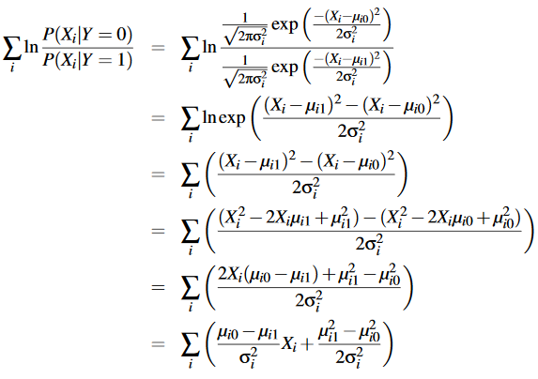




Logistic Regression –Bayesian Analysis
Plug in $P(X_{i}|Y)$

Slide 85
References
https://www.inf.ed.ac.uk/teaching/courses/inf2b/learnnotes/inf2b-learn07-notes-nup.pdf
https://cs229.stanford.edu/summer2019/cs229-notes2.pdf
Tom Mitchell – Chapter 6
https://nlp.stanford.edu/IR-book/pdf/13bayes.pdf

Slide 86
Thank you !
Required Reading for completed session :
T1 - Chapter # 8 (Tom M. Mitchell, Machine Learning)
T1 - Chapter # 6 (Tom M. Mitchell, Machine Learning)
R1 – Chapter # 3 (Christopher M. Bhisop, Pattern Recognition & Machine Learning) & Refresh your MFDS & ISM parallel course basics
Next Session Plan :
Module 9 : Ensemble Learning

